Slide 1


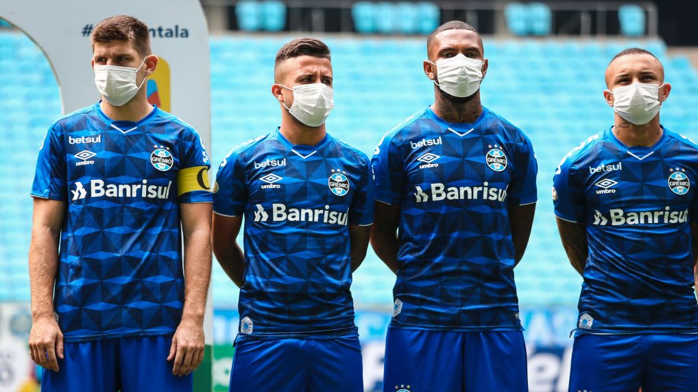
Project No More COVID!
Literally & Figuratively!
Dominic, Nick, Christian, Fang and Kyle
Notes:
Good afternoon everyone. We are group 2, and our team name is “Project No More Covid”. When we originally got together, I had suggested COVID for our theme and was shot down immediately. Hence our name! Team consists of Dominic, Nick, Christy, Fang and myself. Next Slide.

Slide 2


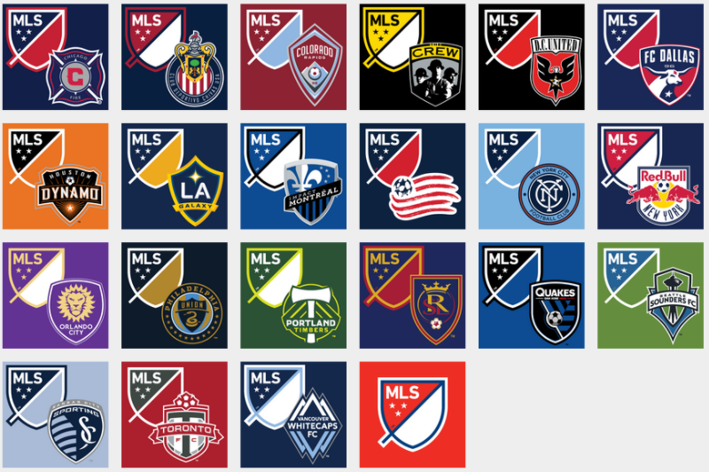

Proposal
Everyone loves sports, right?
Who will be 2021 MLS Cup Champions?
MLS Soccer
Shhh...It’s going to be the Sounders!
Notes:
Discussing possible themes, we each kind of liked sports, and then from there we all generally liked soccer as well, so we decided on the MLS, Major League Soccer, with is a US based soccer league. Once we had our idea, we needed data. When it comes to sports in general, there is usually a ton of data available, and the MLS was no different. We visited Kaggle.com and found a ton of data for the MLS. From here we needed to narrow down our topic of MLS. We decided to do a predictive analysis on who would win the 2021 MLS Cup, which is the championship for the MLS.

Slide 3
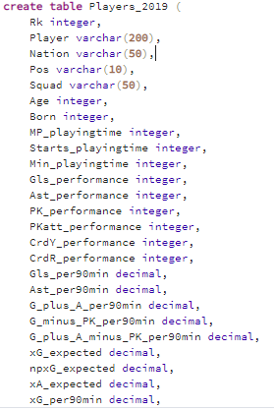
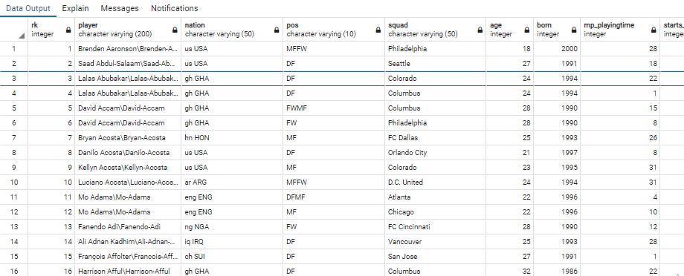
Database
Team/Player Statistics
2015 - Team Statistics
2016 - Team Statistics
2017 - Team Statistics
2018 - Team Statistics
2019 - Team Statistics
2015 - Player Statistics
2016 - Player Statistics
2017 - Player Statistics
2018 - Player Statistics
2019 - Player Statistics
Conference Statistics
2015 - Western Conference
2016 - Western Conference
2017 - Western Conference
2018 - Western Conference
2019 - Western Conference
2015 - Eastern Conference
2016 - Eastern Conference
2017 - Eastern Conference
2018 - Eastern Conference
2019 - Eastern Conference
PostGresQL
Database
Sources: Kaggle.com

Slide 4
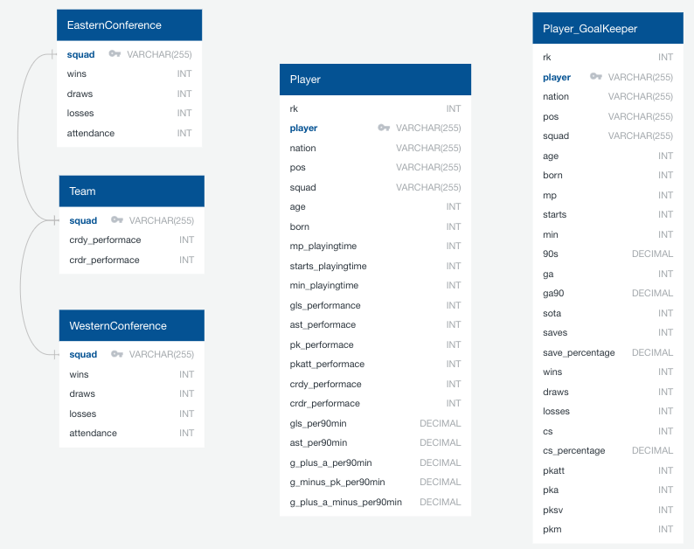
Framework
Focus Variables
Squad
Player
Attendance
Win rates
Number of games played
Playing time
Notes:
A sample year was chosen to illustrate the ERD.

Slide 5
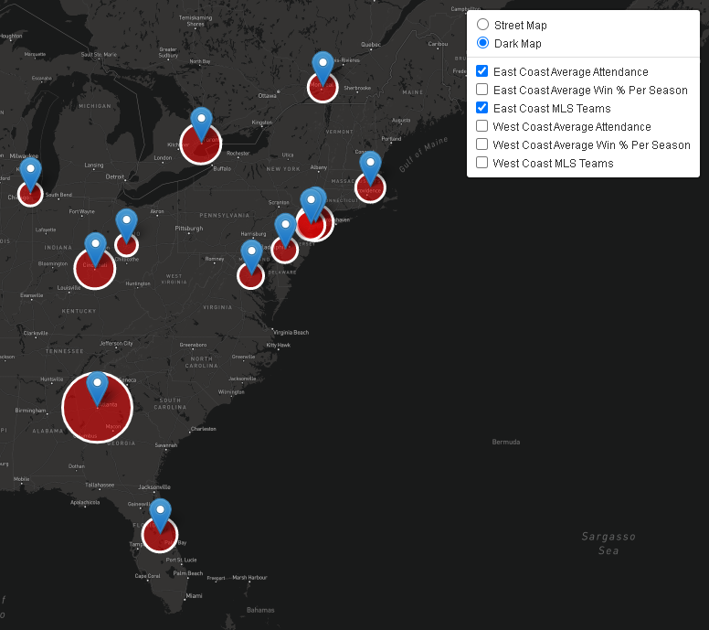
Visualizations - Leaflet (Dom)
Atlanta - 51,237
FC Cincinnati - 27,336
Orlando City - 27,165
Toronto FC - 25,871
NYCFC - 24,570

Slide 6
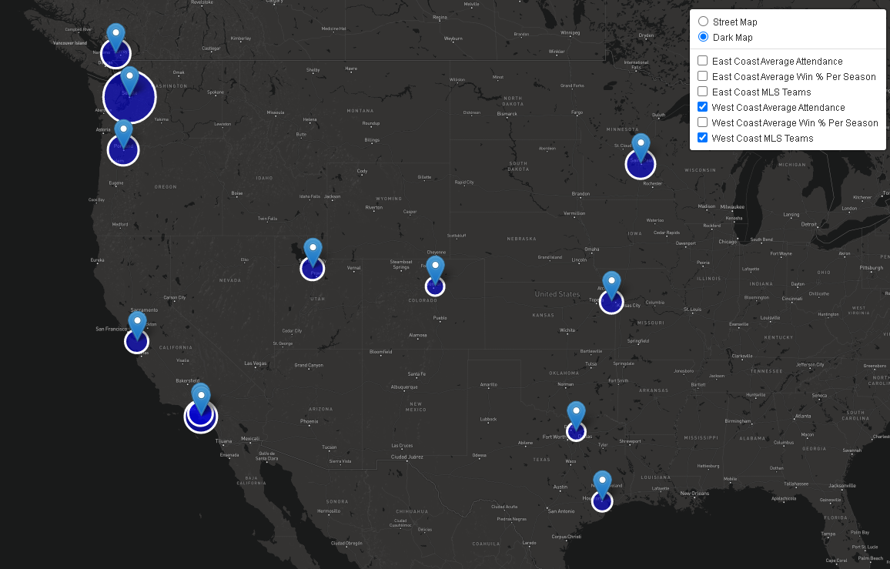
Visualizations - Leaflet (Dom)
Seattle - 37,570
LA Galaxy - 27,857
Portland - 22,408
Los Angeles FC - 22,147
Minnesota - 21,388

Slide 7
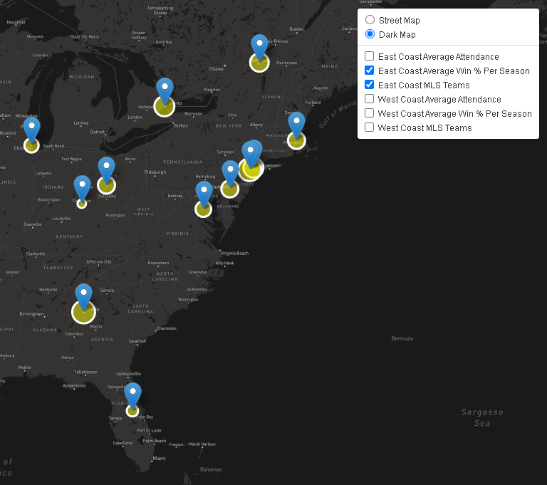
East Coast - Average Win % Regular Season
Atlanta - 53%
NY Red Bulls - 49%
NYCFC - 44%
Toronto FC - 42%
Columbus - 37%

Slide 8
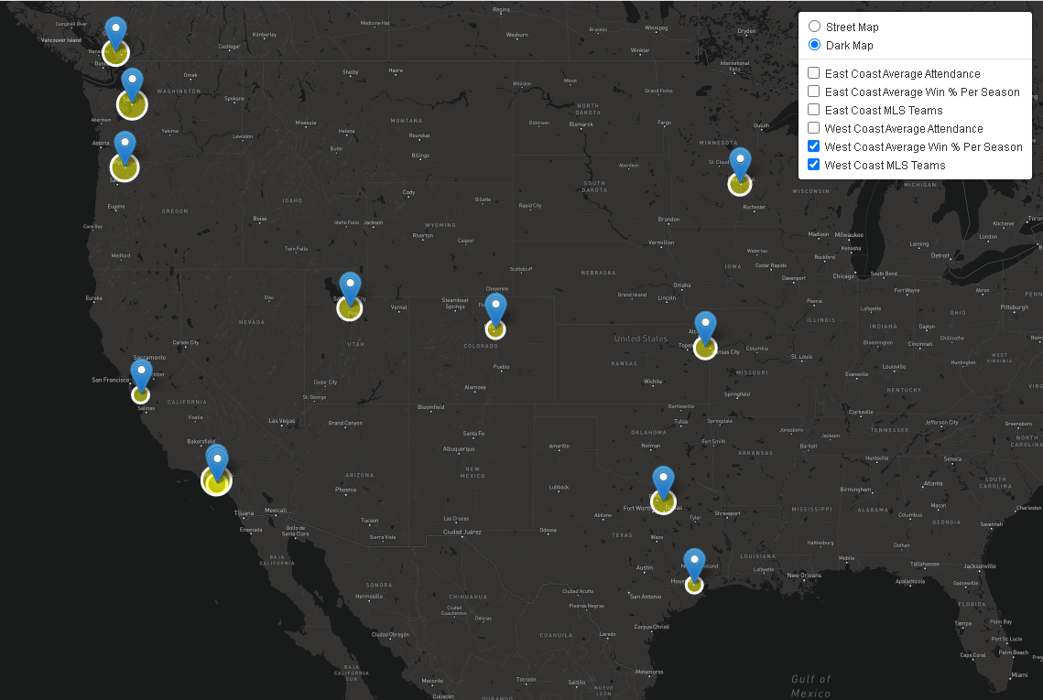
West Coast - Average Win % Regular Season
Los Angeles FC - 54%
Seattle - 45%
FC Dallas - 44%
Portland - 42%
Sporting KC - 39%

Slide 9
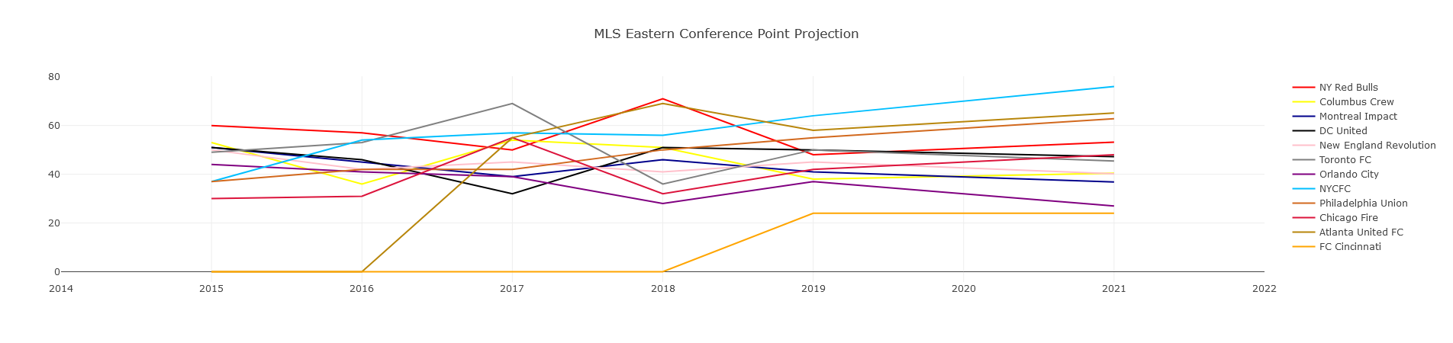
Visualizations - Eastern Conference Point Projection

Slide 10
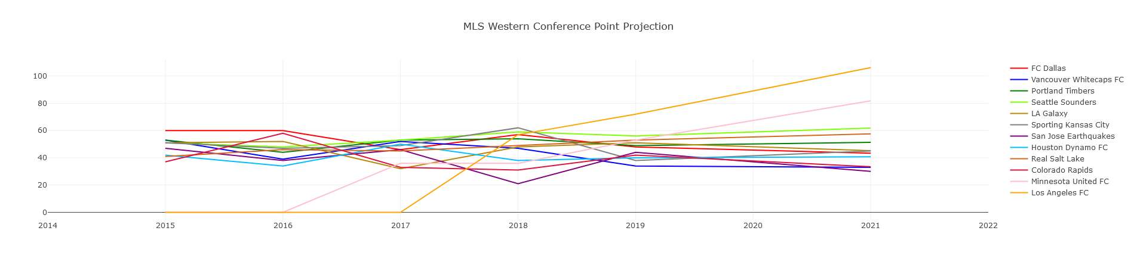
Visualizations - Western Conference Point Projection

Slide 11
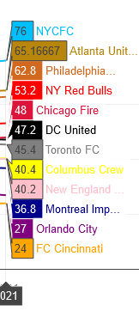
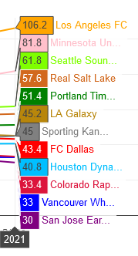
MLS Point Projections
Los Angeles FC - 106.2 points
Minnesota United - 81.8 points
NYCFC - 76 points
Atlanta United - 65.2 points
Philadelphia Union - 62.8 points
Seattle Sounders - 61.8 points
Real Salt Lake - 57.6 points
New York Red Bulls - 53.2 points

Slide 12
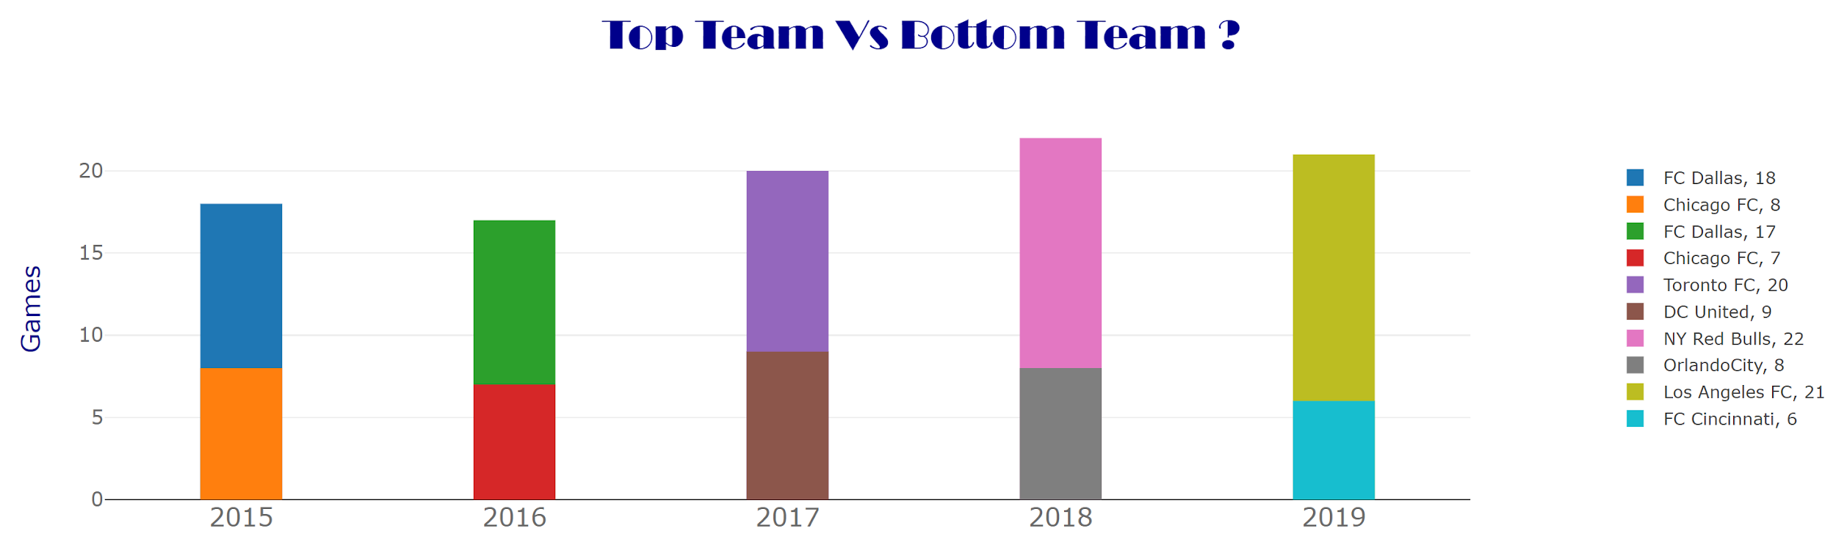
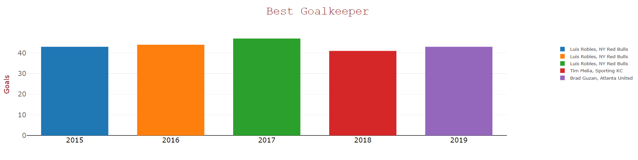
Visualizations - Bar Chart
34 total games played
Played 3060 minutes / 34 games

Slide 13

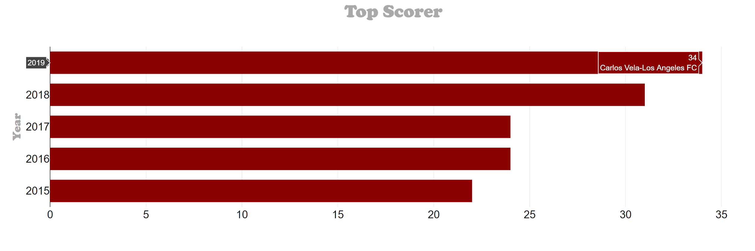
The Best of the Best

Slide 14
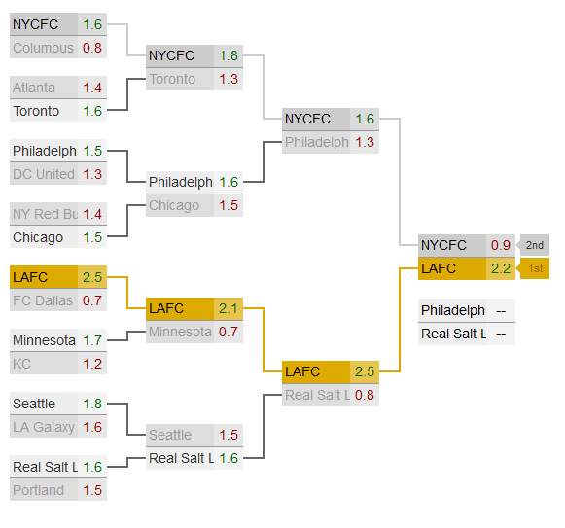
MLS Cup Prediction
LAFC is the predicted champion using the data we retrieved
Based on a function of Goals per 90 minutes and Goals allowed per 90 minutes with every matchup

